Slide 1
Introduction to Programming
Peggy Batchelor

Slide 2
Defining terms
A program is a description in a programming language of a process that achieves some result.
An algorithm is a description of a process in a step-by-step manner.
  The same algorithm could be written in many languages.

Slide 3
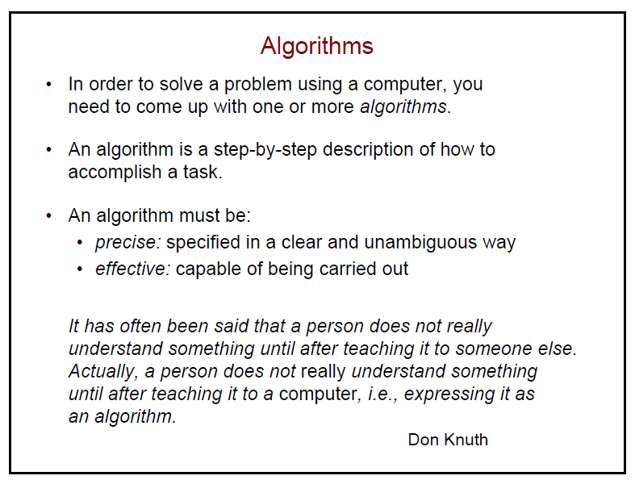

Slide 4
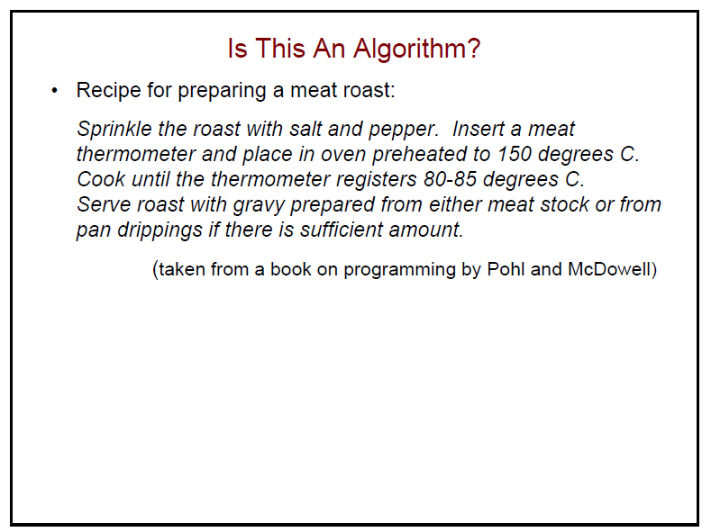

Slide 5
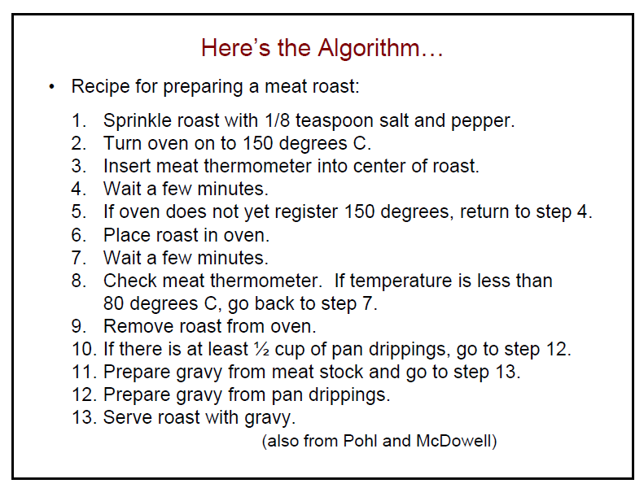

Slide 6
What computers understand
Computers are exceedingly stupid
  The only data they understand is 0’s and 1’s
  They can only do the most simple things with those 0’s and 1’s
    Move this value here
    Add, multiply, subtract, divide these values
    Compare these values, and if one is less than the other, go follow this step rather than that one.
  Done fast enough, those simple things can be amazing.

Slide 7
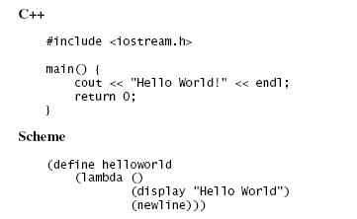
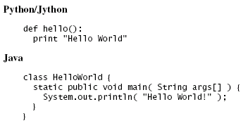
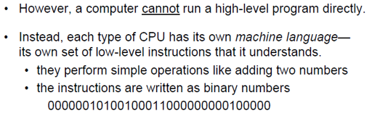
Programming Languages
Different programming languages are different ways (encodings) that turn into (same/similar) commands for the computer

Slide 8
Python
The programming language we will be using is called Python
  http://www.python.org
Python is a popular programing language, which is designed to be easy to read.
Used by many companies.
    It’s used by companies like Google, Industrial Light & Magic, Pixar, Nextel, and others
Also used to make application software flexible and expendable.
  For example, can be used to program GIMP or Blender

Slide 9
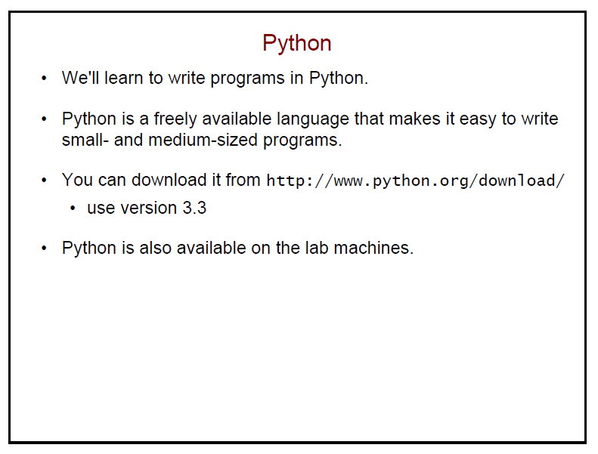

Slide 10
A word about Jython
Jython is Python
Python is a language implemented in C.
Jython is the same language implemented in Java.
  Is the pizza different if a different company makes the flour? If so, not by much.

Slide 11
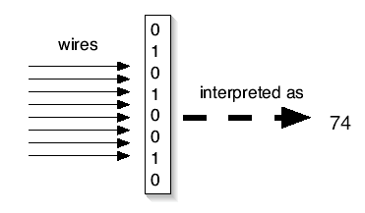
Key Concept: Encodings
We can interpret the 0’s and 1’s in computer memory any way we want.
  We can treat them as numbers.
  We can encode information in those numbers
Even the notion that the computer understands numbers is an interpretation
  We encode the voltages on wires as 0’s and 1’s,
  eight of these defining a byte
  Which we can, in turn, interpret as a decimal number

Slide 12
Computation for Communication
All media are going digital
Digital media are manipulated with software
You are limited in your communication by what your software allows
  What if you want to say something that Microsoft or Adobe or Apple doesn’t let you say?

Slide 13
Programming is a communications skill
If you want to say something that your tools don’t allow, program it yourself
If you want to understand what your tools can or cannot do, you need to understand what the programs are doing
If you care about preparing media for the Web, for marketing, for print, for broadcast… then it’s worth your while to understand how the media are and can be manipulated.
Knowledge is Power,
Knowing how media work is powerful and freeing

Slide 14
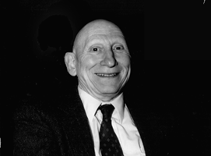
Knowing about programming is knowing about process
Alan Perlis
  One of the founders of computer science
  Argued in 1961 that Computer Science should be part of a liberal education: Everyone should learn to program.
    Perhaps computing is more critical to a liberal education than Calculus
    Calculus is about rates, and that’s important to many.
    Computer science is about process, and that’s important to everyone.
  Automating process
  changes everything.

Slide 15
Programming is about Communicating Process
A program is the most concise statement possible to communicate a process
  That’s why it’s important to scientists and others who want to specify how to do something understandably in as few words as possible

Slide 16
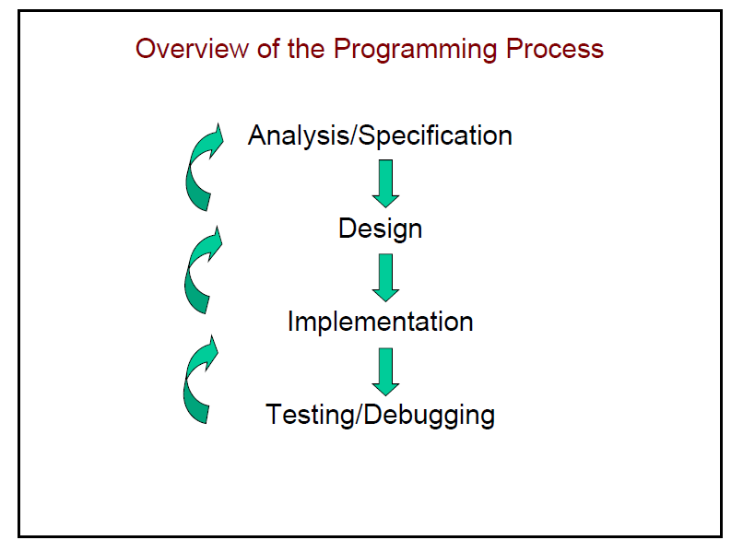

Slide 17
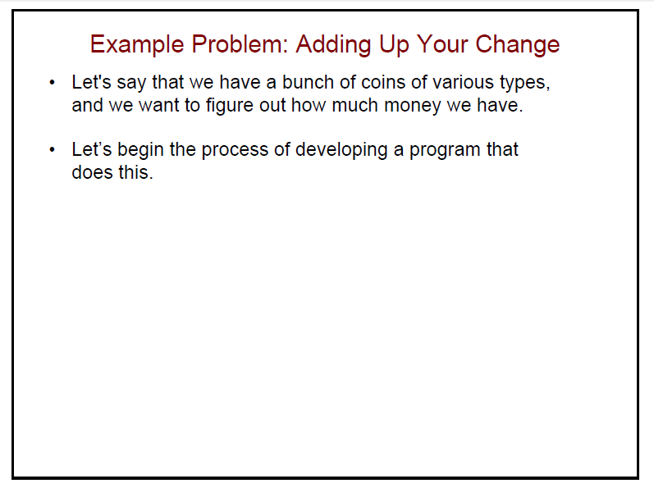

Slide 18
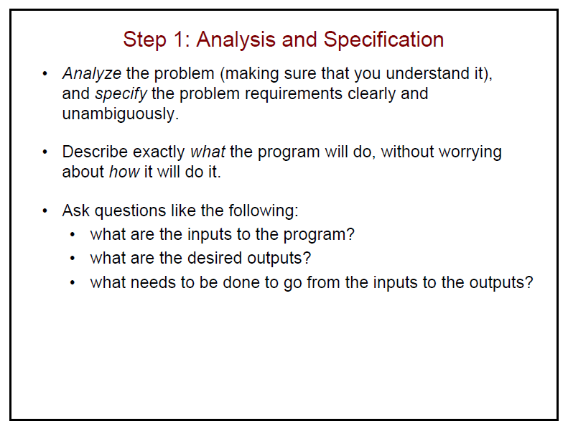

Slide 19
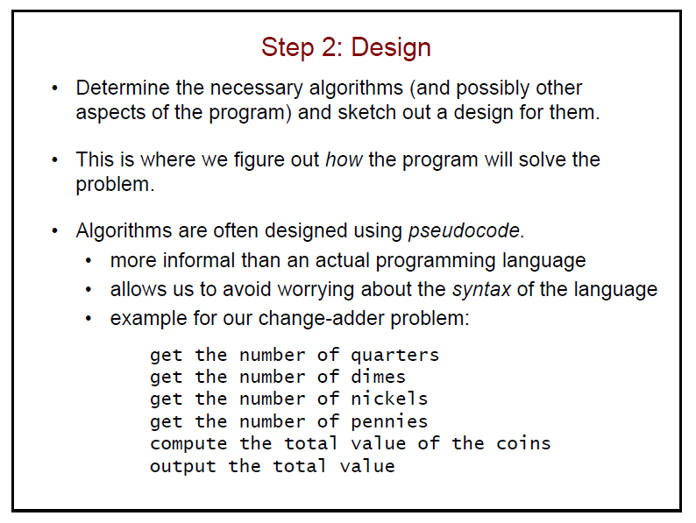

Slide 20
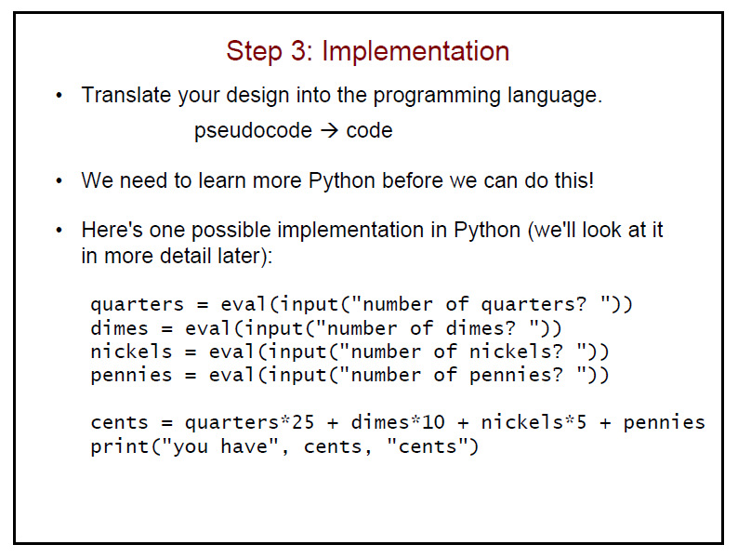

Slide 21
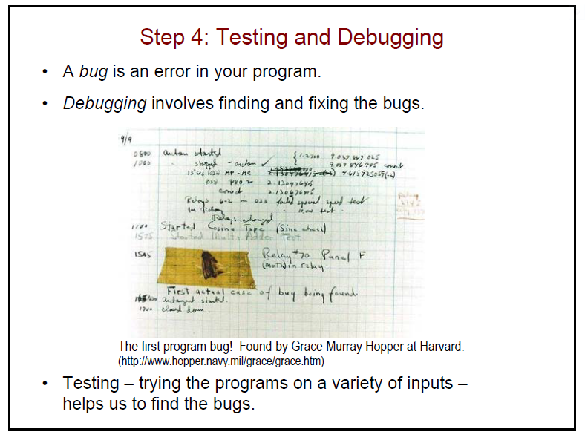

Slide 22
Key Words, Operators, and Syntax: an Overview
Key words: predefined words used to write program in high-level language
  Each key word has specific meaning
Operators: perform operations on data
  Example: math operators to perform arithmetic
Syntax: set of rules to be followed when writing program
Statement: individual instruction used in high-level language

Slide 23
Compilers and Interpreters
Programs written in high-level languages such as Python must be translated into machine language to be executed
Compiler: translates high-level language program into separate machine language program
  Machine language program can be executed at any time

Slide 24
Compilers and Interpreters (cont’d.)
Interpreter: translates and executes instructions in high-level language program
  Used by Python language
  Interprets one instruction at a time
  No separate machine language program
Source code: statements written by programmer
  Syntax error: prevents code from being translated

Slide 25
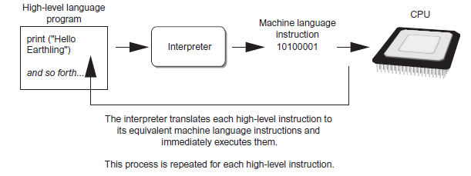
Compilers and Interpreters (cont’d.)
Figure 1-19 Executing a high-level program with an interpreter

Slide 26
Using Python
Python must be installed and configured prior to use
  One of the items installed is the Python interpreter
Python interpreter can be used in two modes:
  Interactive mode: enter statements on keyboard
  Script mode: save statements in Python script

Slide 27
Interactive Mode
When you start Python in interactive mode, you will see a prompt
  Indicates the interpreter is waiting for a Python statement to be typed
  Prompt reappears after previous statement is executed
  Error message displayed If you incorrectly type a statement
Good way to learn new parts of Python

Slide 28
Writing Python Programs and Running Them in Script Mode
Statements entered in interactive mode are not saved as a program
To have a program use script mode
  Save a set of Python statements in a file
  The filename should have the .py extension
  To run the file, or script, type
  python filename
  at the operating system command line

Slide 29
The IDLE Programming Environment
IDLE (Integrated Development Program): single program that provides tools to write, execute and test a program
  Automatically installed when Python language is installed
  Runs in interactive mode
  Has built-in text editor with features designed to help write Python programs

Slide 30
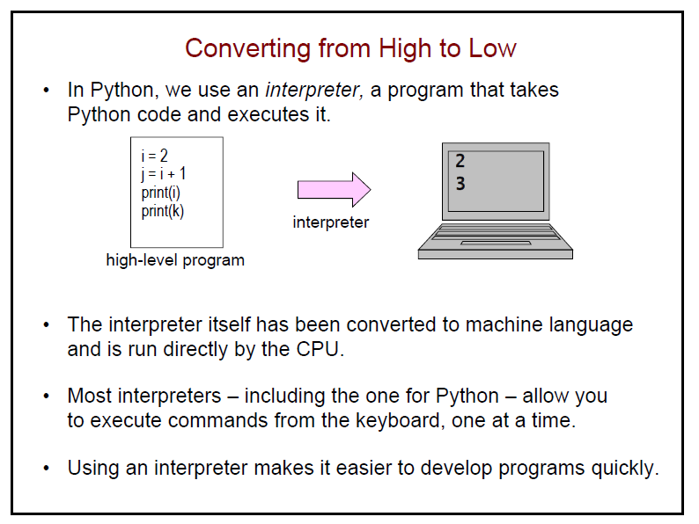

Slide 31
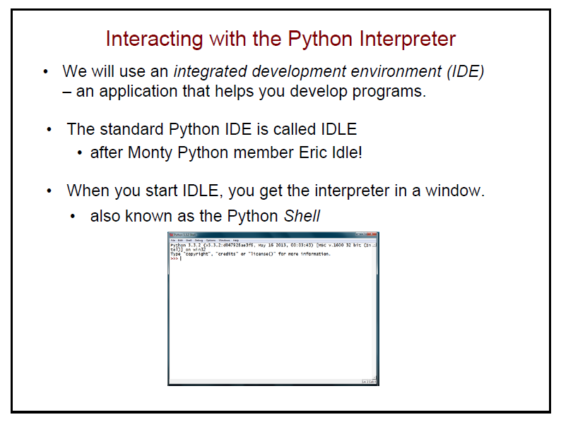

Slide 32
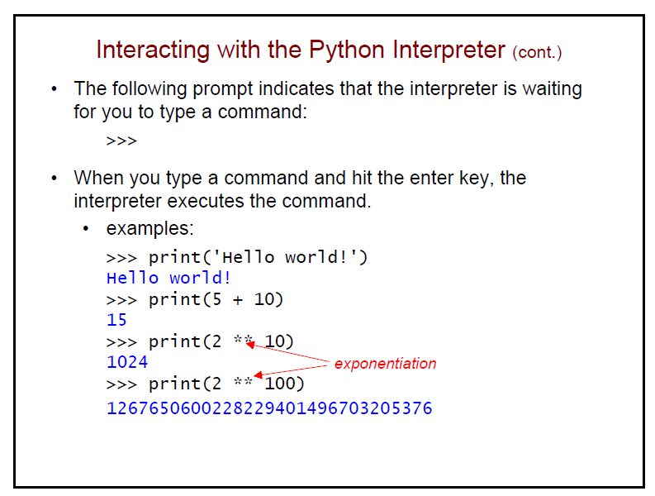

Slide 33
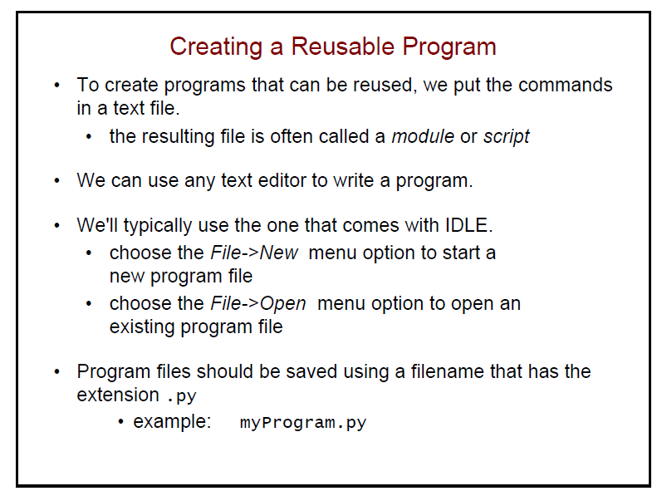

Slide 34
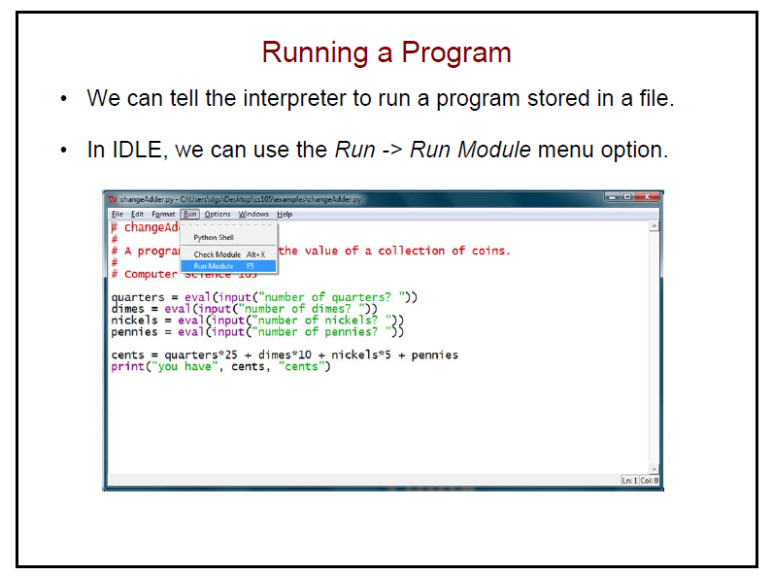

Slide 35
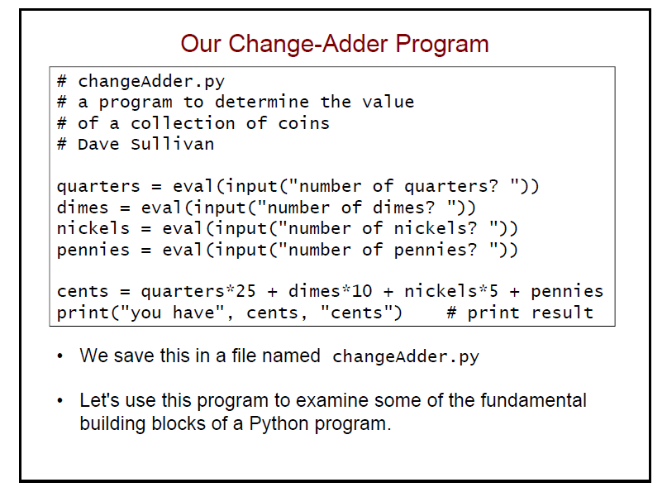

Slide 36
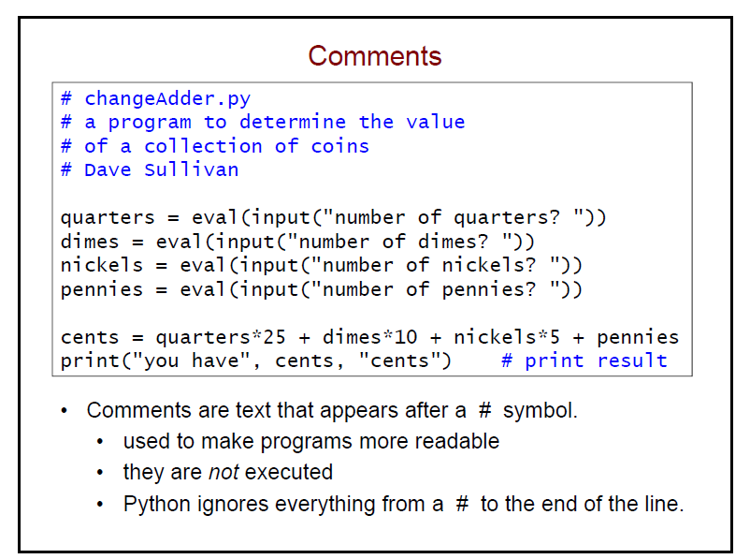

Slide 37
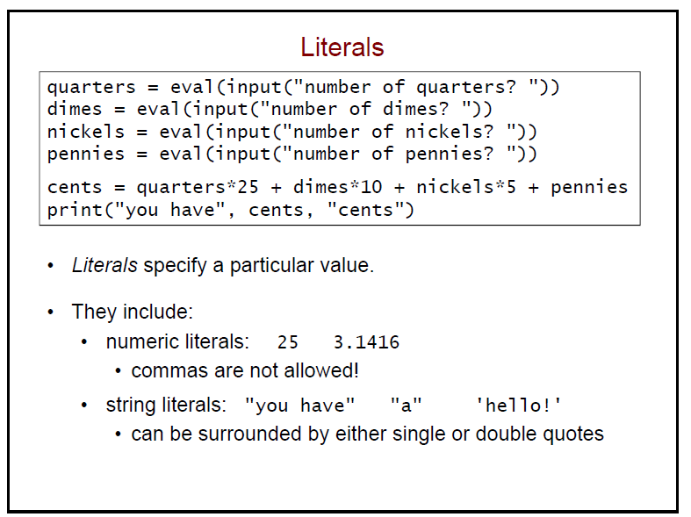

Slide 38
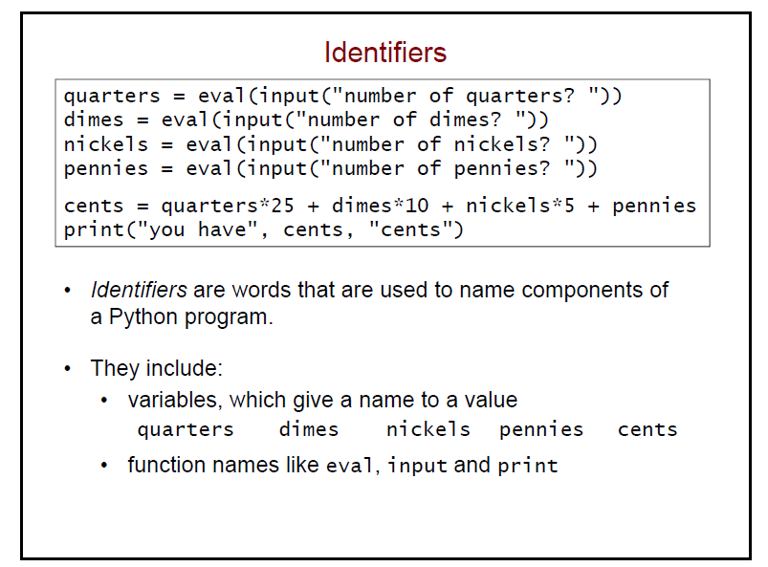

Slide 39
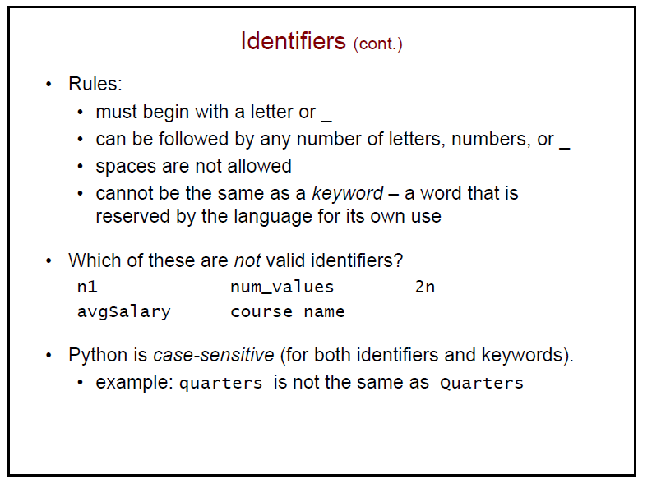

Slide 40
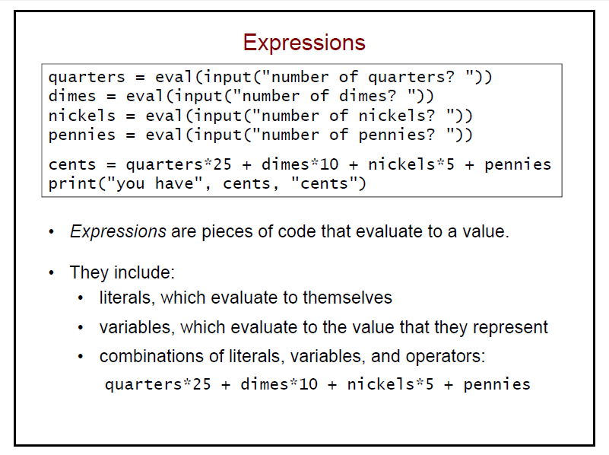

Slide 41
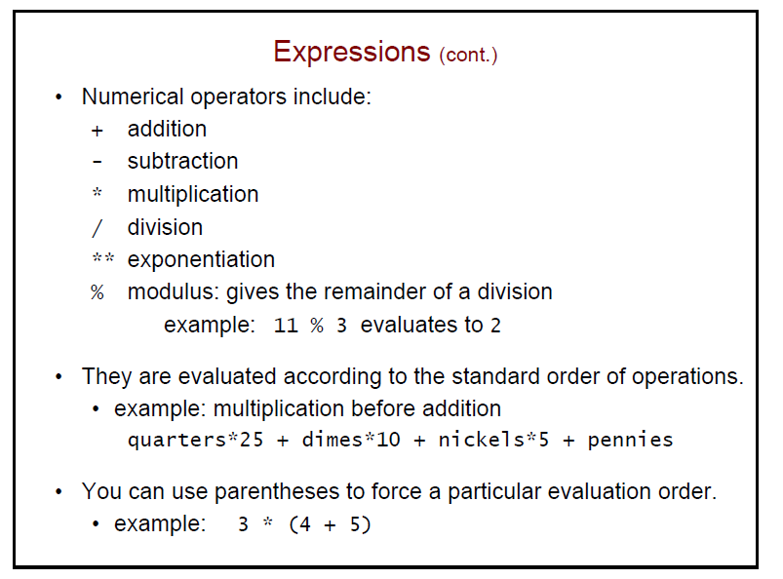

Slide 42
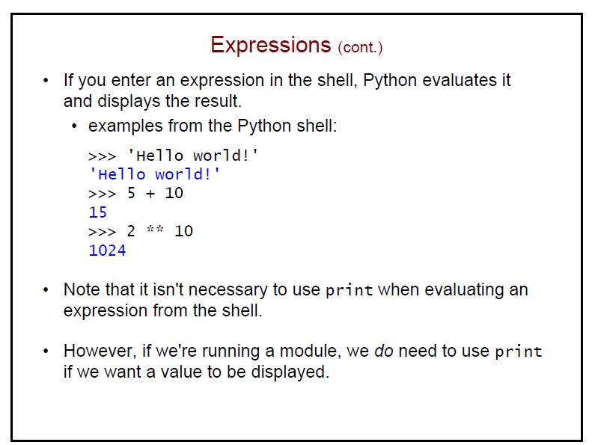

Slide 43
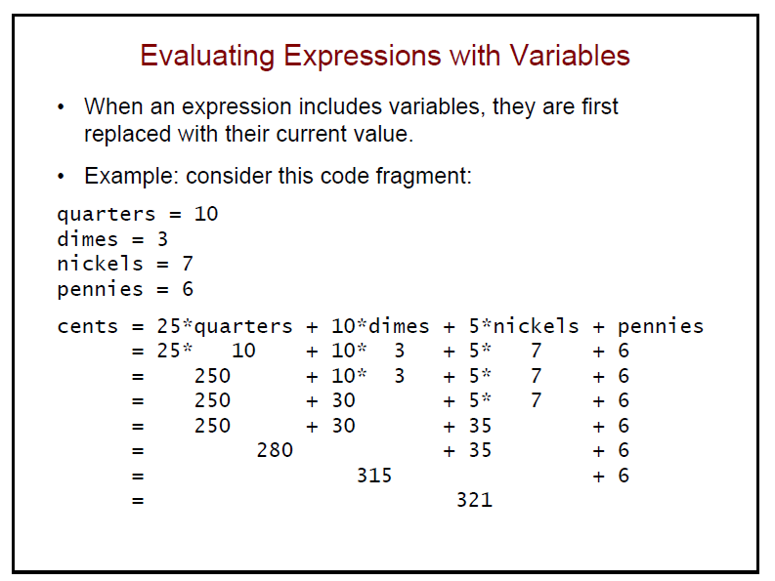

Slide 44
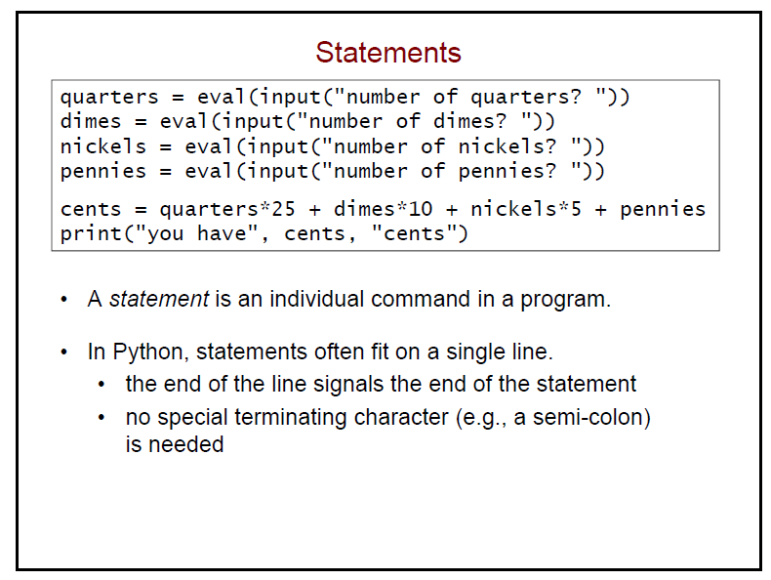

Slide 45
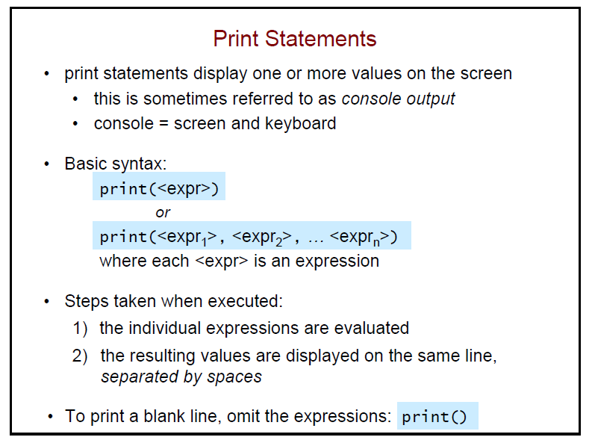

Slide 46
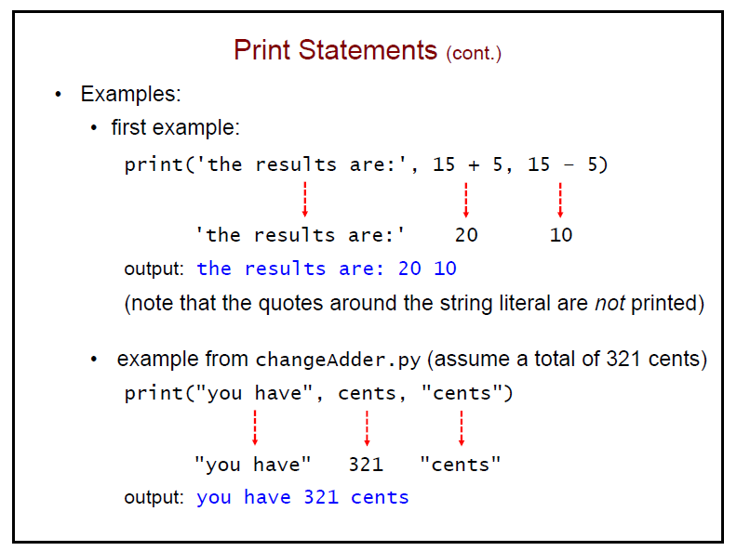

Slide 47
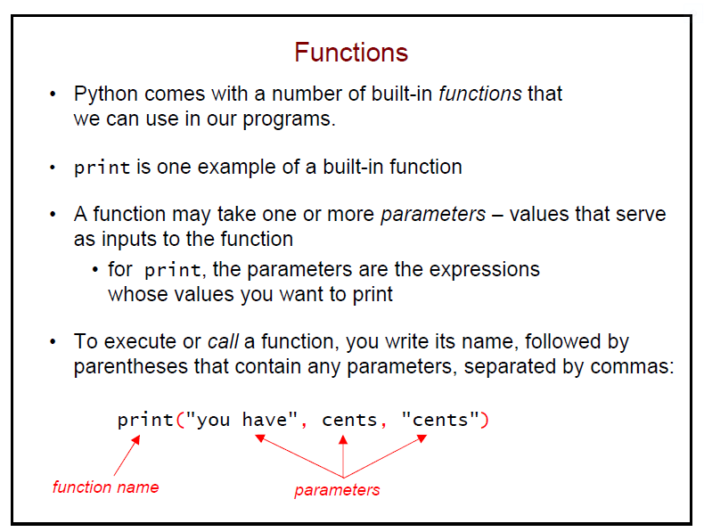

Slide 48
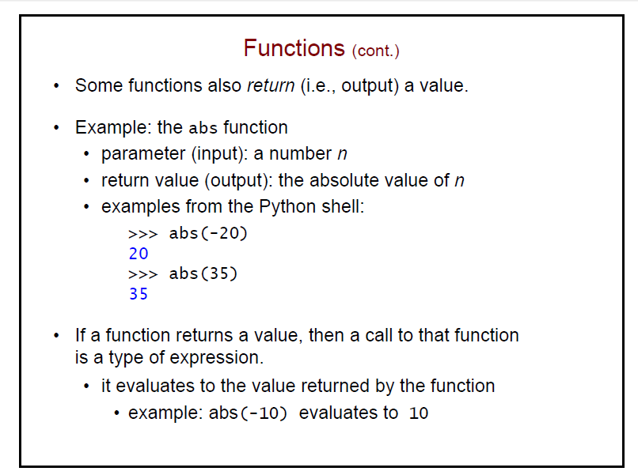

Slide 49
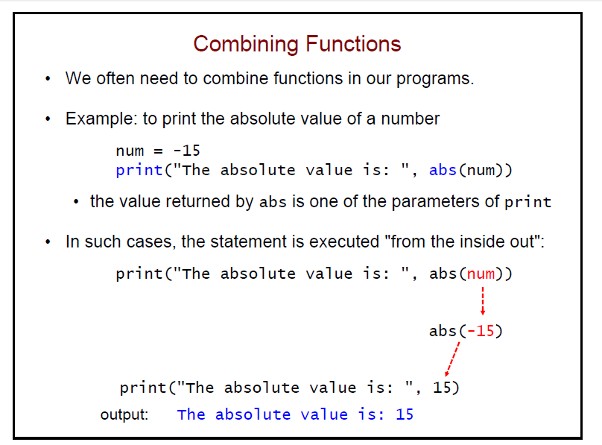

Slide 50
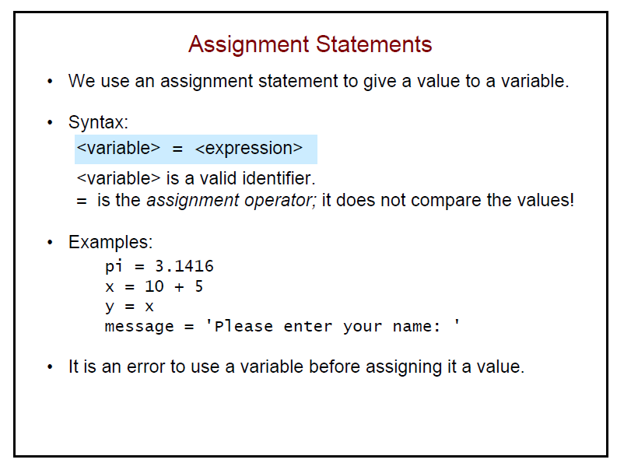

Slide 51
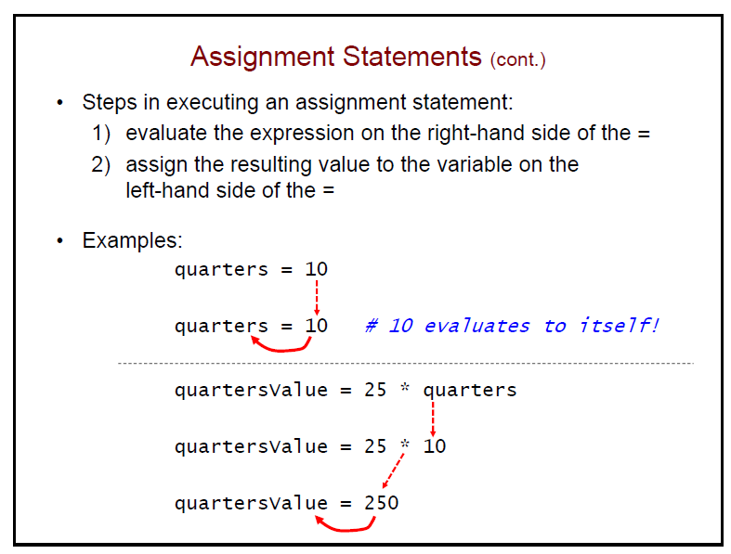

Slide 52
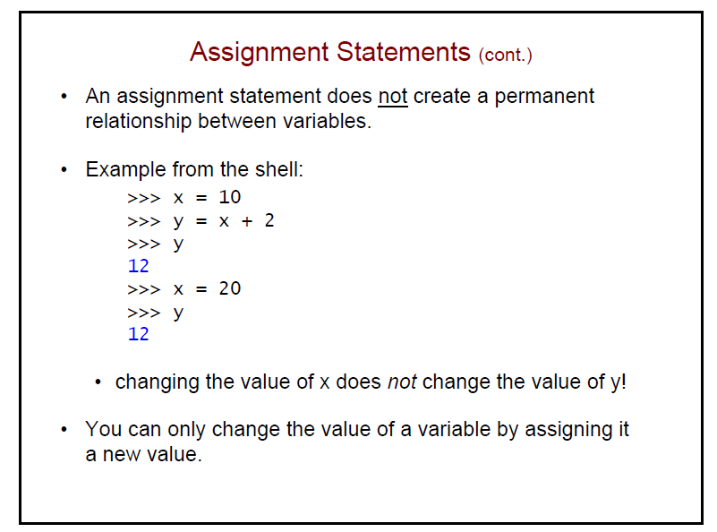

Slide 53
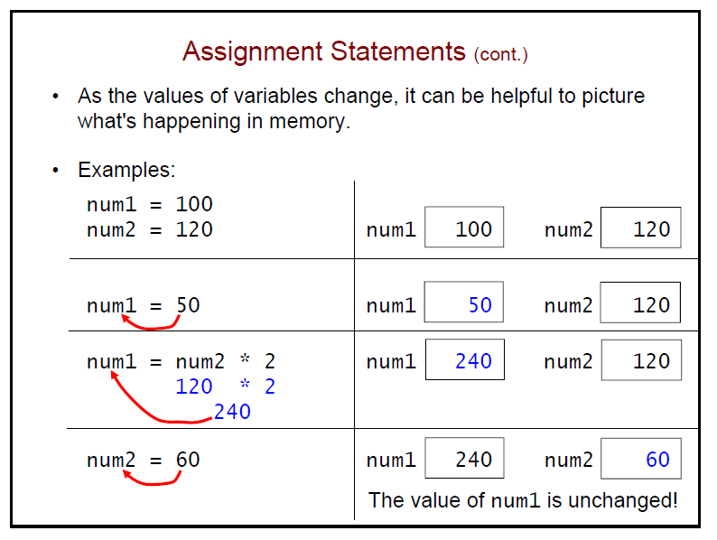

Slide 54
